Slide 1
GTU CSE 495
UNDERSIGHT
Detecting the Suspicious Object on Vehicle Underbody Images
MUSTAFA BERKAY BAYGUT
1901042633
Proje Danışmanı: Doç. Dr. Habil KALKAN
KASIM 2023

Slide 2
Content
Project Scheme and Definition
Project Design Plan
Project Requirements
Success Criteria
Source

Slide 3
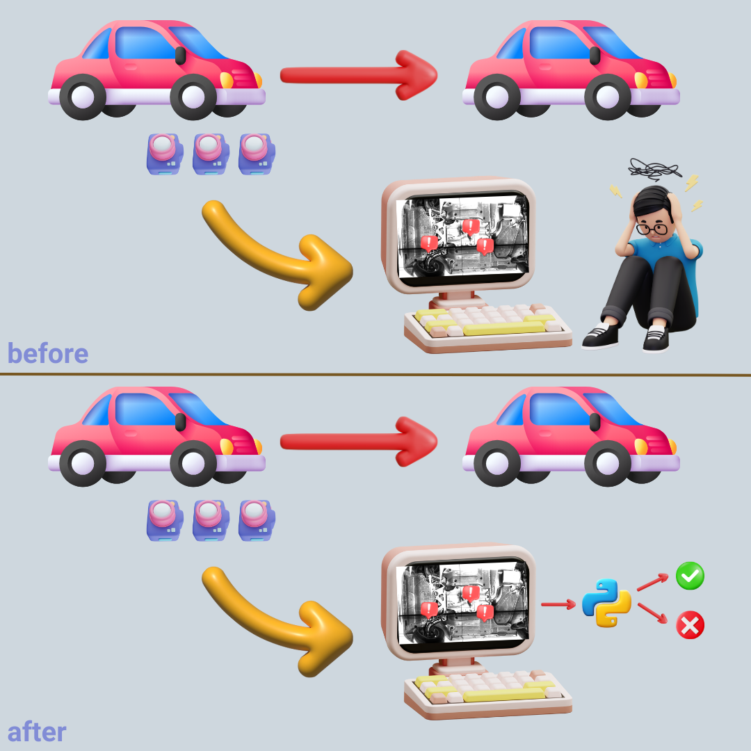
Project Scheme and Definition
UNDERSIGHT
“Undersight” is a secure gate keeping algorithm to detect suspicious object undercarriage images of the car.
First it process the images to check if there is a suspicious object or not.
After it locates the where objects is.

Slide 4
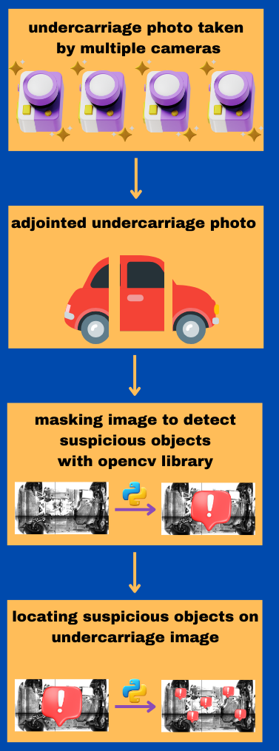
Project Design Plan
First it will takes some images from the under of the car
After photos will be adjointed with outsource services.
In that part photos will be masking to detect foreign objects and anomalies undercarriage photos.
After detection objects will be located on the screen.

Slide 5
Proje Requirements - 1
Implement preprocessing techniques, including resizing, noise reduction, and background removal, to enhance the quality and consistency of the images.
Implement edge detection algorithms (e.g., Canny edge detector) to identify object boundaries accurately.
Implement feature extraction methods (e.g., texture analysis, color histograms) to capture object characteristics.
Develop algorithms for object segmentation to isolate suspicious objects from the background effectively.
Analyze the size, shape, and texture of detected objects to identify potential threats.

Slide 6
Proje Requirements - 2
Dataset: Dataset provided from outsource adjoined and ready to use.
Programming Language: Python is commonly used for image processing tasks due to its rich libraries and ease of use.
Image Processing Libraries:
OpenCV: Provides functions for resizing, noise reduction, edge detection(Canny), object segmentation etc.
Scikit-image: Used for tasks like texture analysis and color histograms

Slide 7
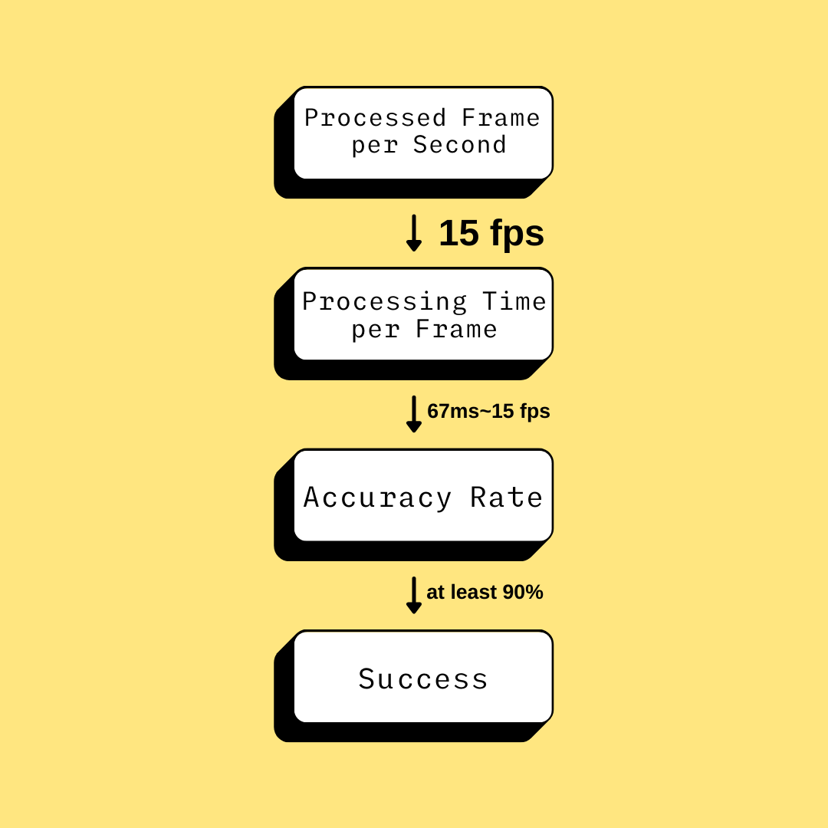
Success Criteria

Slide 8
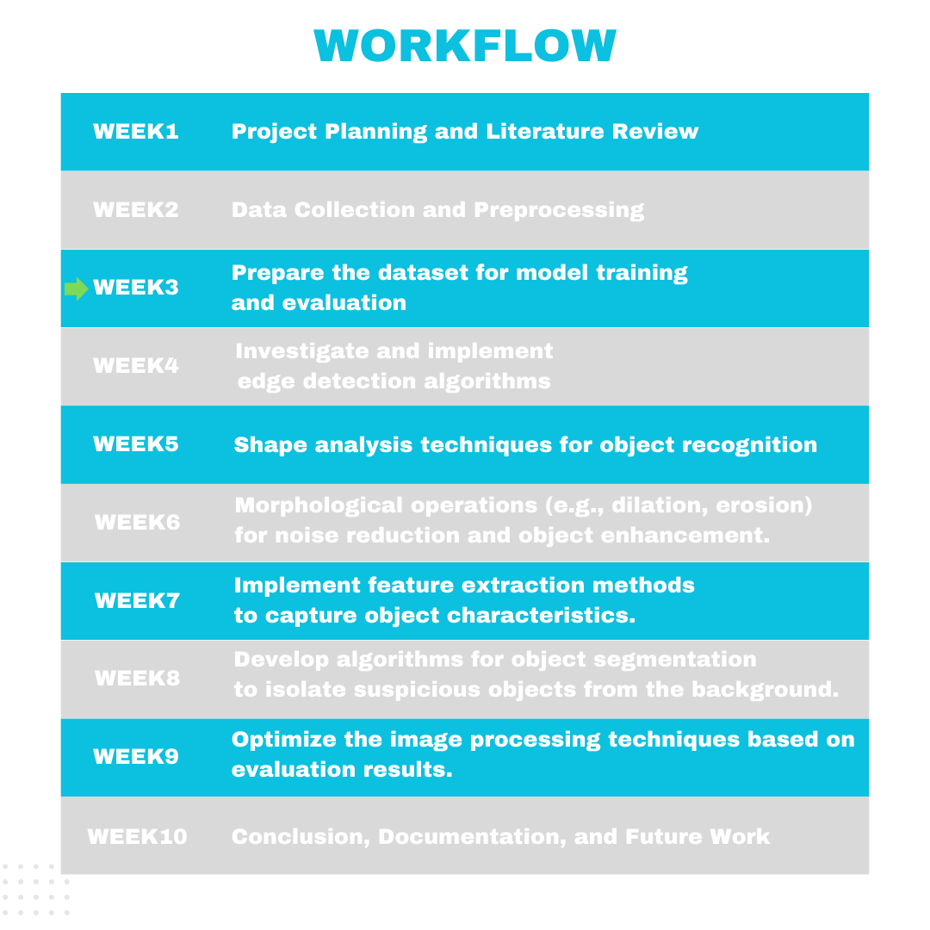
Workflow Plan

Slide 9
Kaynaklar
IVUS Gatekeeper Security, https://www.gatekeepersecurity.com/products/intelligent-vehicle-undercarriage-scanner/
Vehicle Undercarriage Scanning System, https://sear.unisq.edu.au/536/1/frederickCHONGchuenkiong-2005.pdf

